Slide 1

Understanding Career Aspirations & Workplace Expectations of Gen-Z
: By Vipin V S

Slide 2
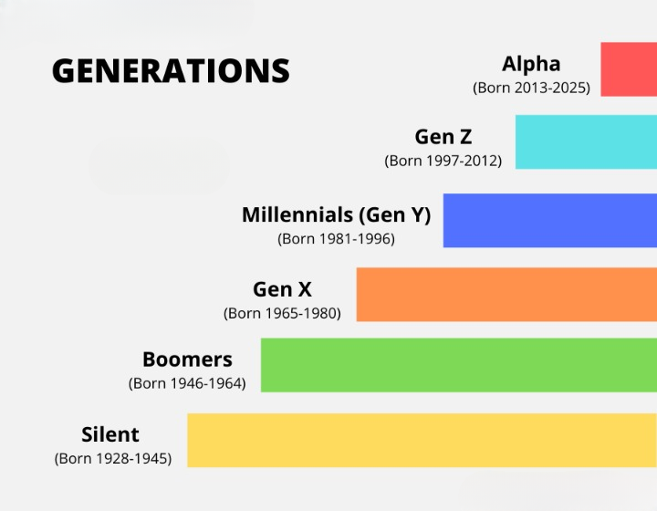

Slide 3
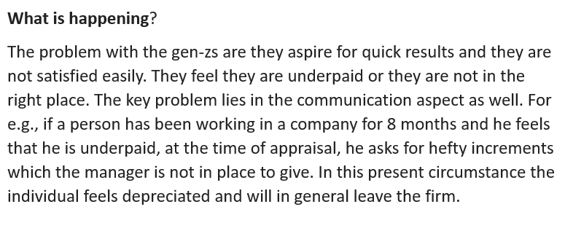
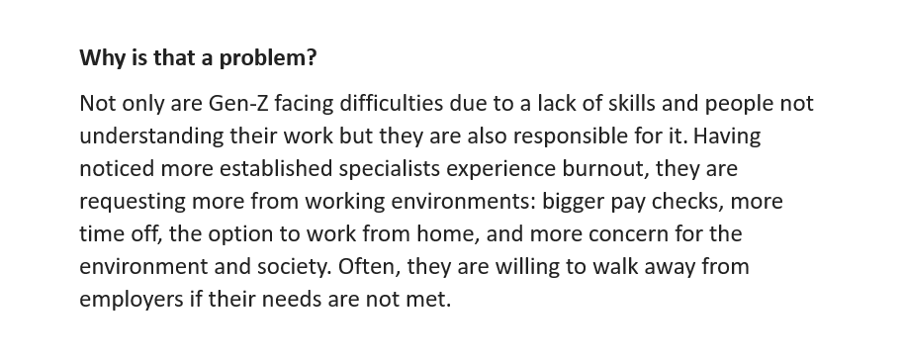
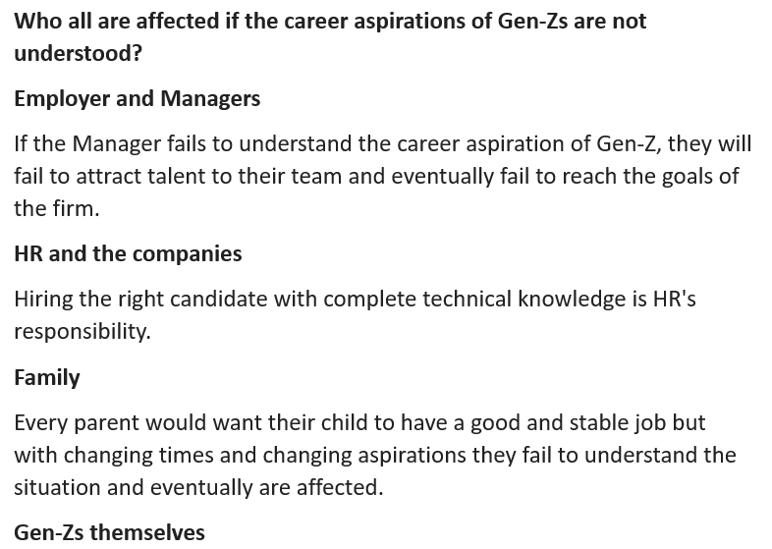
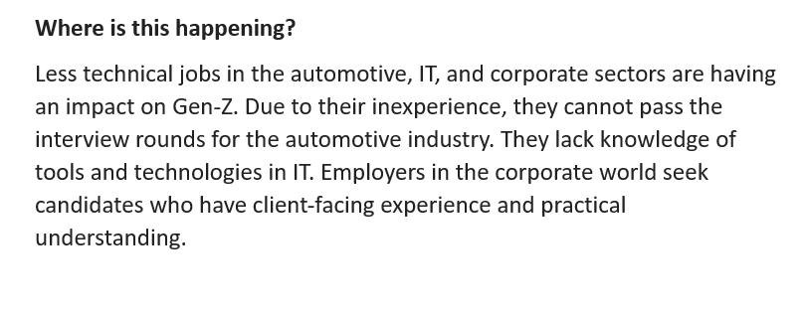
Present Scenario : Addressing the 4 W’s ?

Slide 4

Problem Statement: For Better Understanding
Understanding Career Aspirations of Gen-Z
For this problem statement, we are going to understand about the Career Aspirations of Generation-Z who are going to be the 32% of the total workforce by 2026, their contributions will be huge in the prospect of our countries and world economic growth.
This analytical learning is focused towards understanding the gap which might help the recruiters address and at the same time to have right people on board.
Few articles for a small minutia:
https://www.workdesign.com/2022/08/authentically-gen-z-the-values-aspirations-drivers-that-will-re-define-the-future-of-work/
https://hbr.org/2023/01/helping-gen-z-employees-find-their-place-at-work

Slide 5






LEARNING ROADMAP
Data Analysis using SQL
Addressing key business Questions
Data Collection
Different methods used to collect Data
Data Visualization
Build effect dashboards to visualize it
Creating Business Research Document
Knowing who all are involved in i.e, Key stakeholders
Insight Generation/ Findings
Seek Business findings
Problem Statement
Understanding the key problem which need to be addressed

Slide 6
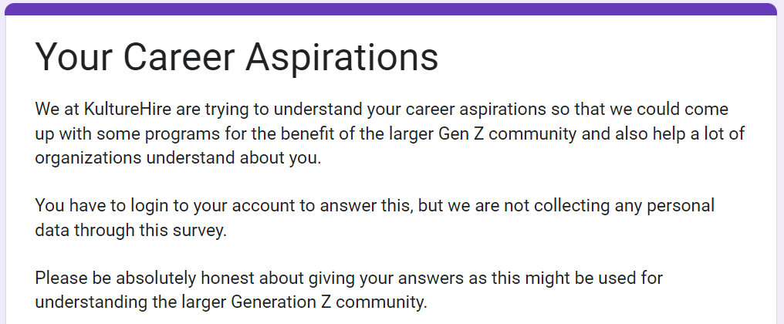
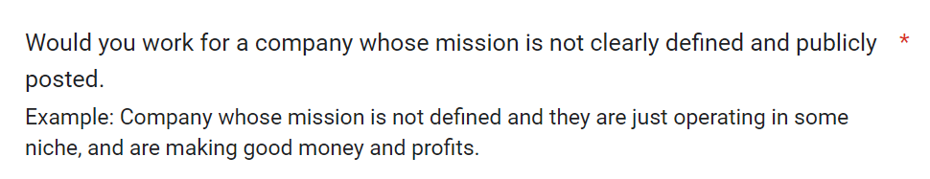
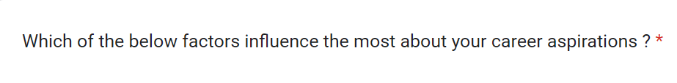
Data Collection via Questionnaire
Data was gathered from the Gen-Zs through almost every social media platforms like LinkedIn, Facebook, WhatsApp, Gmail, Instagram etc.
We received around 3400+ complete forms and about 50000 responses. The responses were roughly from 1800 different Postal codes across India.

Slide 7
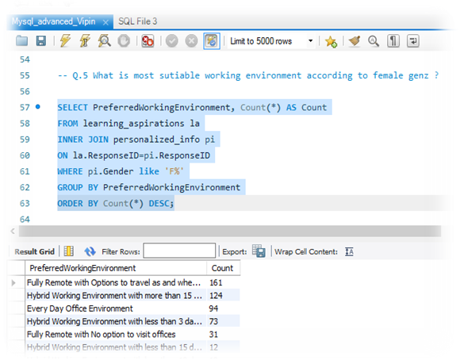
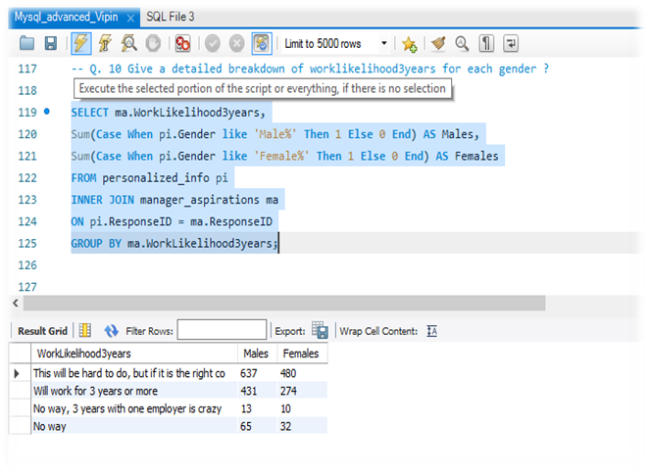
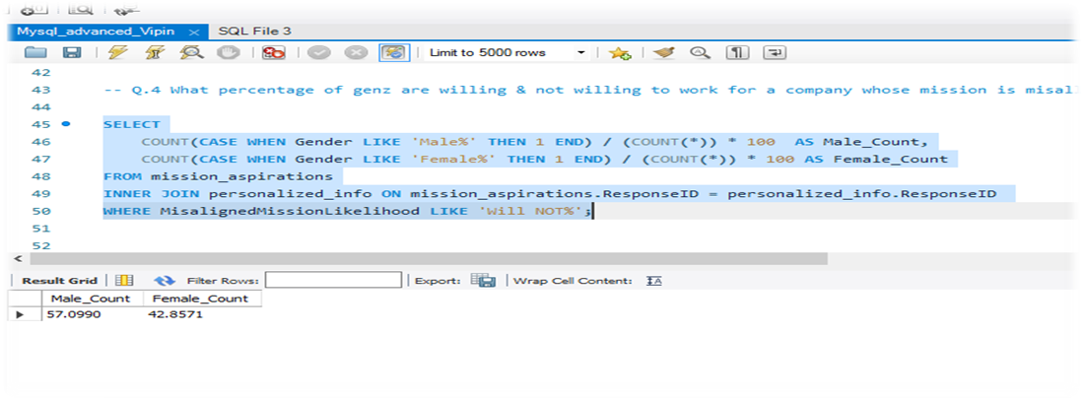
Understanding business questions using MYSQL
Working were done on MYSQL workbench.
Data were imported from csv and xlsx files to the server.
Wrote SQL codes to understand the business answers and also to get insights while solving various business questions too.

Slide 8
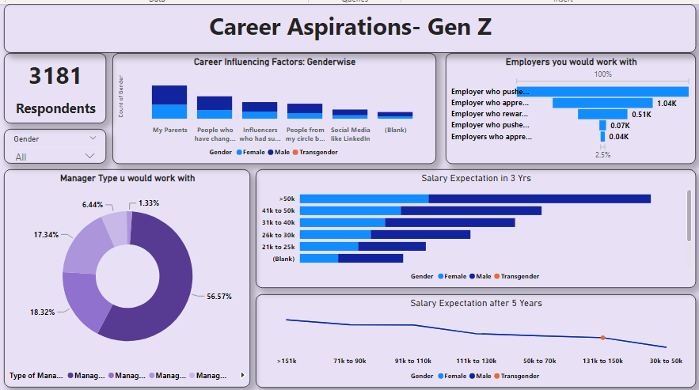
Executive / Comprehensive Dashboard

Slide 9
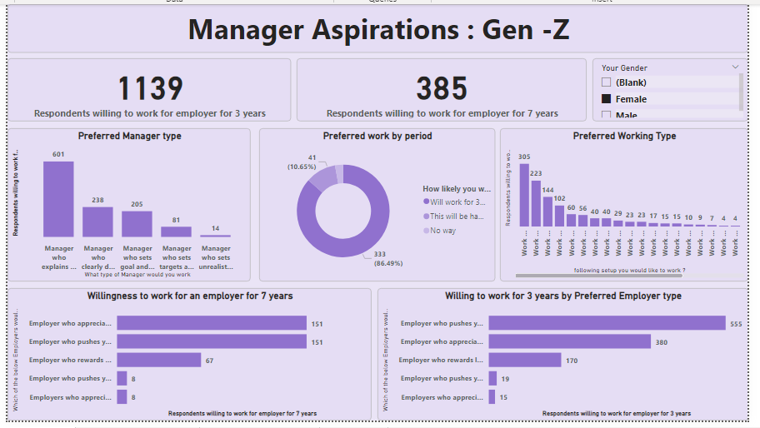
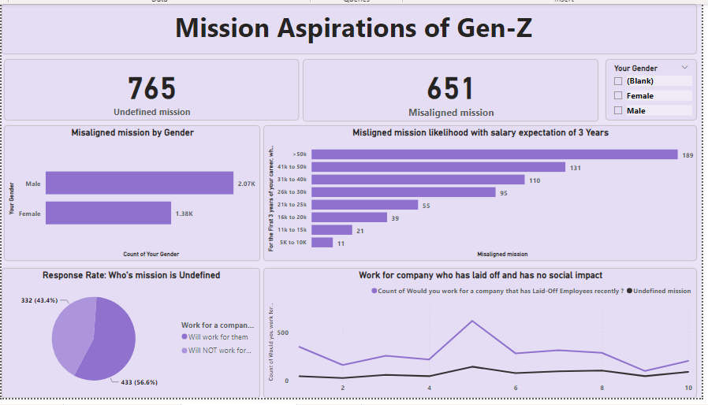
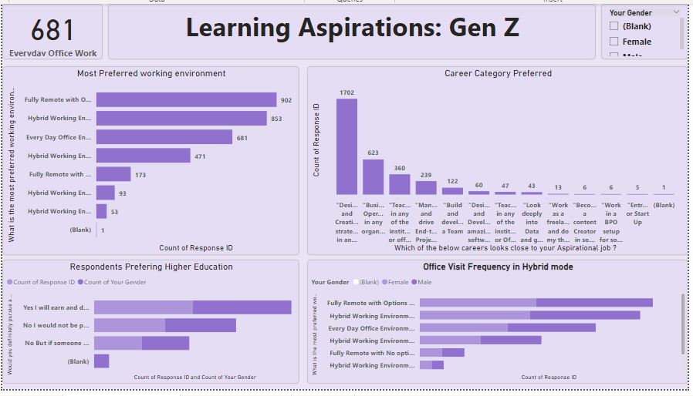
Focus Area/ Dashboards
Created 3 dashboards in Power-Bi to have a deep visual understanding
Manager aspirations
Mission aspirations.
Learning aspirations.

Slide 10

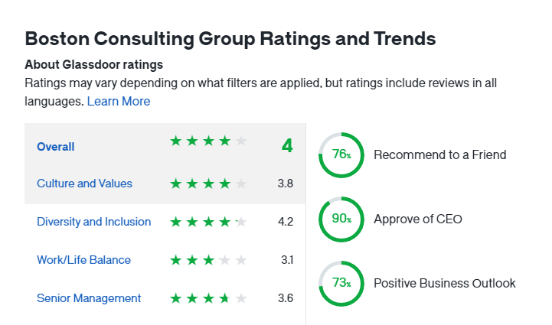
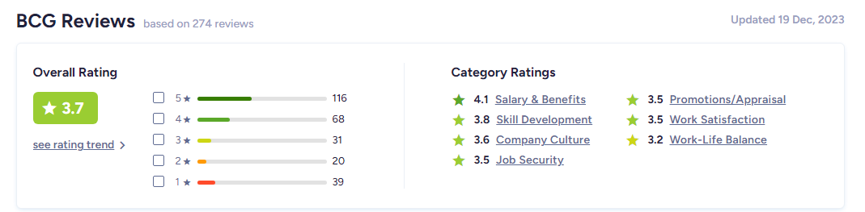
Employer Overview: Will Gen-Z work for BCG ?
Company Profile
Founded in 1963 by Bruce Henderson.
BCG is an American global consulting company with 30000 employees.
Help companies reimagine strategy and value creation in a fast-paced world.
Partners with industries like Aerospace & Defense. Automotive, Consumer Products , Education, Energy, Financial Institutions, Health Care, Industrial Goods, Insurance.
Ratings
Has an overall rating of 4.0 out of 5 in Glassdoor, based on 8000 reviews.
In ambition box has a rating of 3.7 out of 5 from 270 reviews.
Concerns / Problem Areas
Employees reported to have poor work life balance and unfair treatment at workplace.

Slide 11
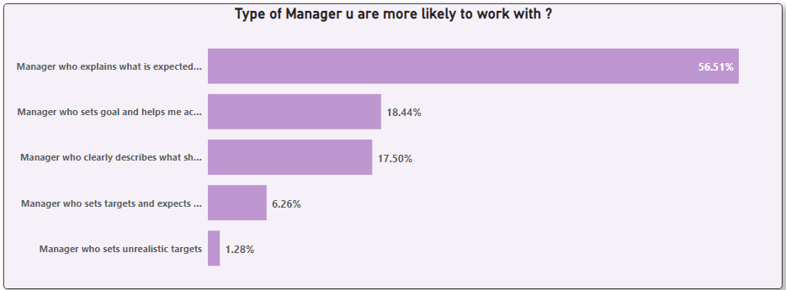
Insight 1 & Recommendations
Recommendations
57 % of employees have preferred to work under a manager who explains what is expected and who guides them in achieving those goals.
Least preferred managers are those who set unrealistic goals and doesn’t help them address those issues.
Set Realistic expectations & provide clear communications.
Having an effective Mentorship, training programs, and skill-building opportunities.
Workload assessment as well as leadership training.
Use employee surveys regularly for feedback.

Slide 12
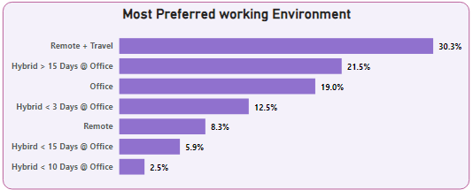
Insight 2 & Recommendations
Recommendations
30 % of gen-z have preferred to Remote & another 21.5 have preferred hybrid working model.
Everyday office culture are only to limited percent.
Enrich Flexible work arrangements.
Promote Time off and encourage breaks to avoid burnouts.
Need for cutting-edge tools, digital communication, and tech-savvy environments are highly preferable.

Slide 13
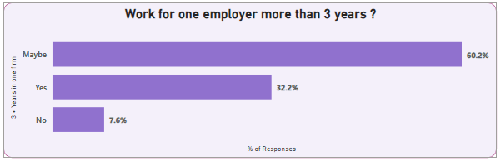
Insight 3 & Recommendations
Recommendations
Emphasize the value of collaboration and teamwork thereby building a ecosystem of trust and inclusive work culture.
Explore the desire to for healthy work life balance & Discuss strategies for promoting well-being and mental health in the workplace as well.
Implement Wellness program as well as regular training and development & Employee assistance program(EAP).
Delegating Responsibilities would yet be another thing which can be considered during workload.

Slide 14
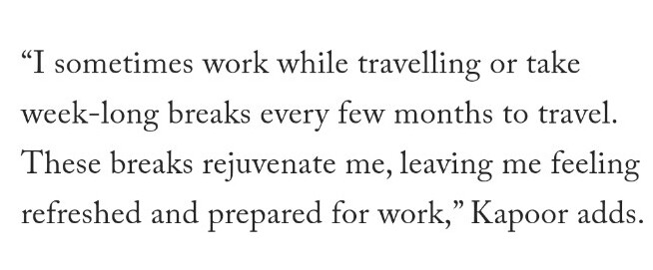
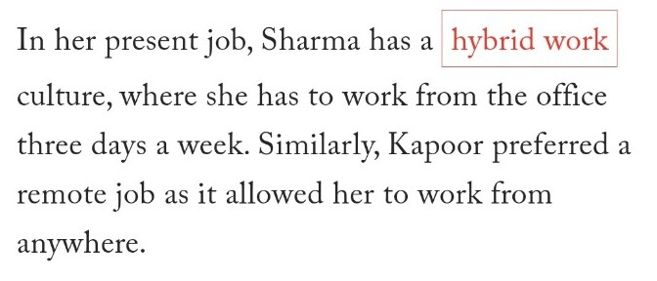
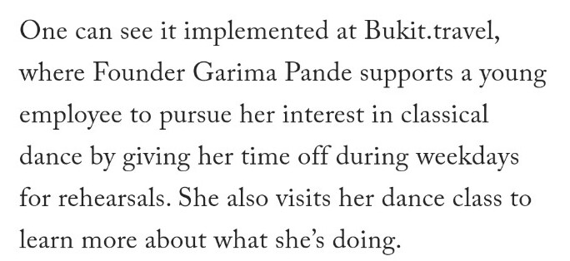
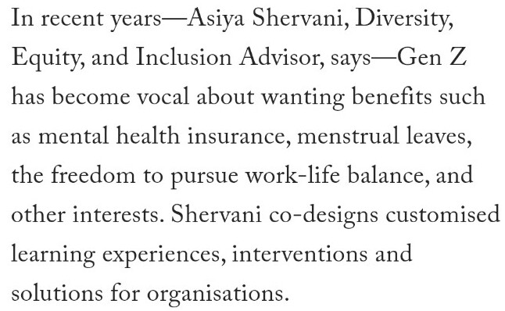
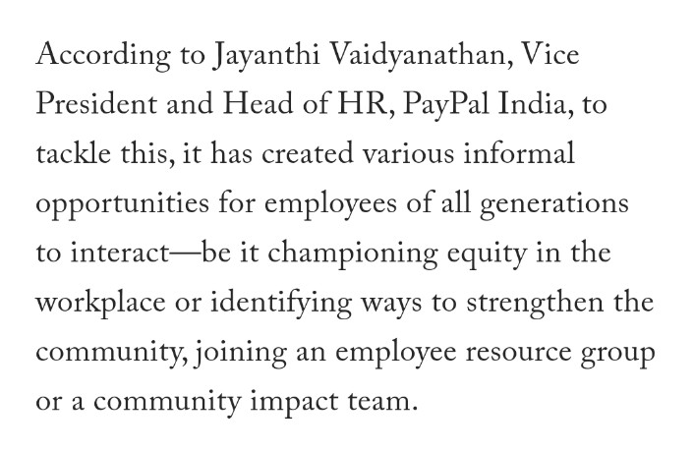
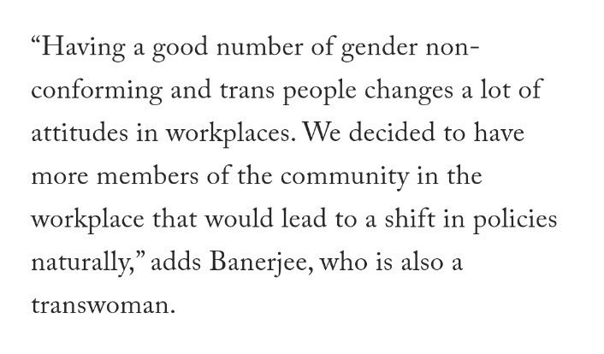
Public Voices

Slide 15


